Slide 1

{{ AngularJS Fundamentals }}

Slide 2



{{ Arjay Elbore }}
Front-end Developer
@virtualoverride
https://github.com/VirtualOverride

Slide 3
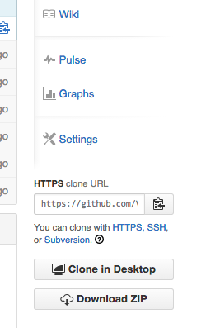
{{ Exercises and Demo App }}
git clonehttps://github.com/VirtualOverride/ng-demo.git
Or go to
https://github.com/VirtualOverride/ng-demo
Click the download button

Slide 4

{{ Agenda }}
AngularJS Features
Getting Started
Views, Directives, and Filters
Modules, Controllers, and Scope
Routing
Factories and Services

Slide 5
{{ Target Audience }}
Developers with experience using the following
HTML
CSS
Javacript

Slide 6
{{ Features }}

Slide 7
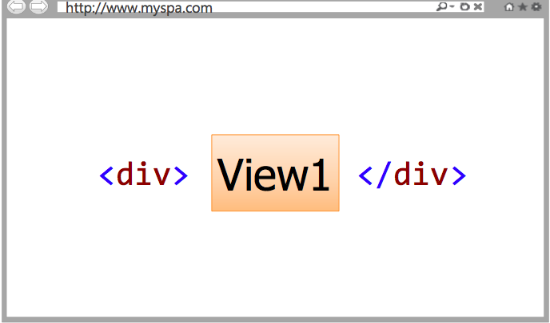
{{ Single Page Application (SPA) }}
SPAs allow different views (screens) to be loaded into a shell page as the user interacts with the page

Slide 8
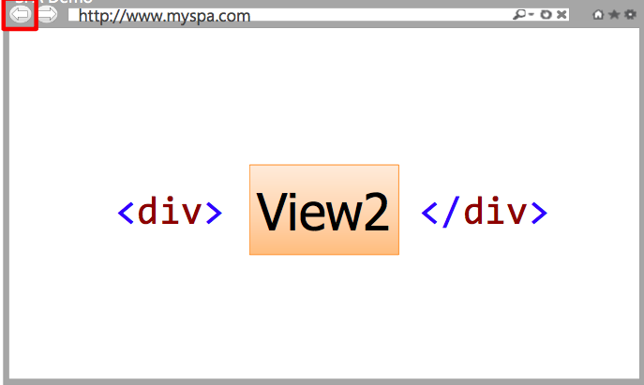
Views can be replaced with other views
SPAs maintain a history of views that have been displayed

Slide 9
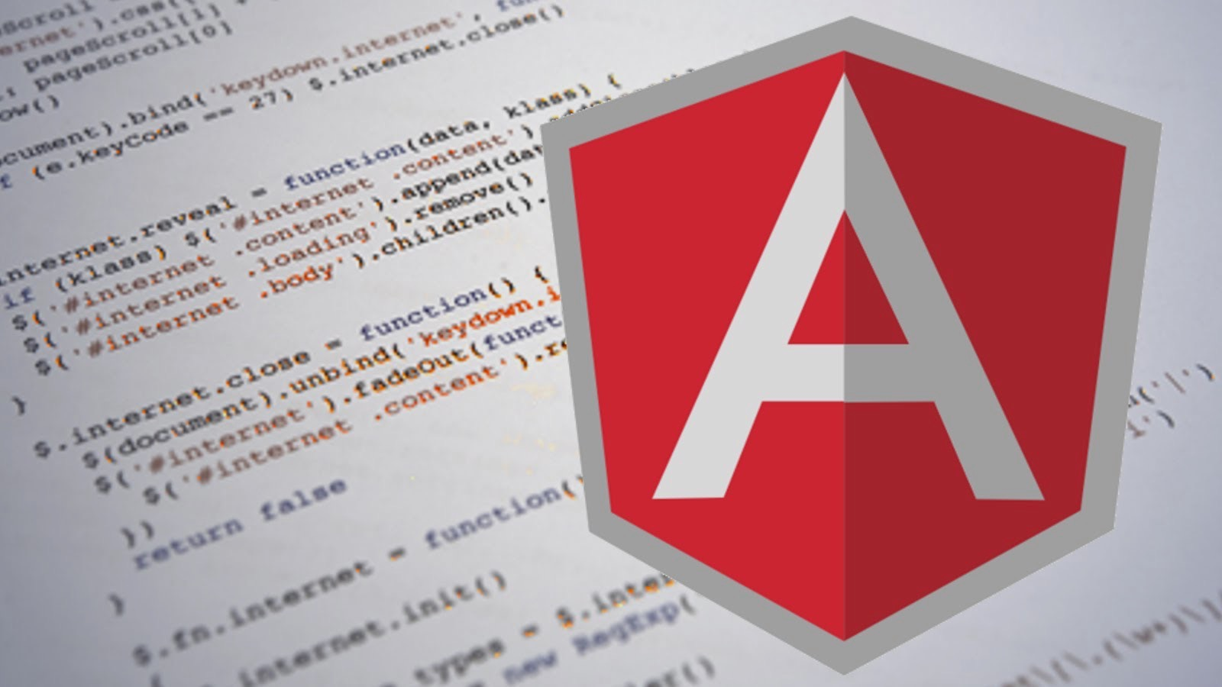
{{ SPA Issues and challenges }}
DOM Manipulation
History
Module Loading
Data Binding
Caching
Object Modeling
More…

Slide 10

{{ Super.Angular }}

Slide 11
{{ AngularJS is a full-featured SPA Framework }}

Slide 12
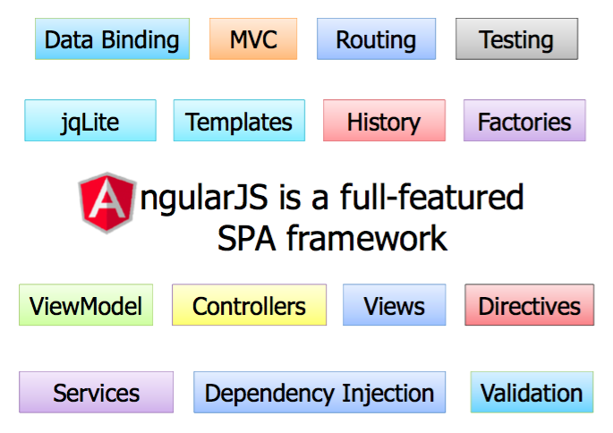

Slide 13
{{ Getting Started }}

Slide 14

Steps to get started
Download angularjs javascript framework
Reference to your html page
Add ng-app directive
Bind data using directives

Slide 15
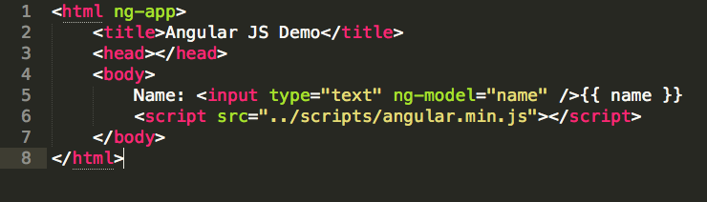
{{ Hello.World code }}

Slide 16

{{ Key Players in AngularJS }}

Slide 17

{{ The Key to Learn AngularJS }}
Understand the available parts
Understand how the parts fits together
Understand how to organize parts

Slide 18
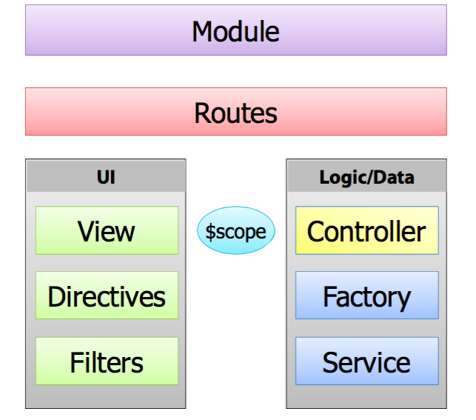
{{ The Key to Learn AngularJS }}

Slide 19
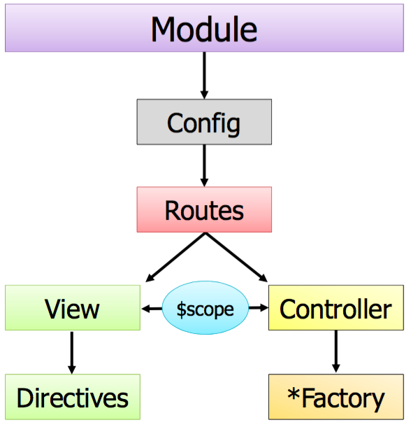
{{ Big Picture }}

Slide 20
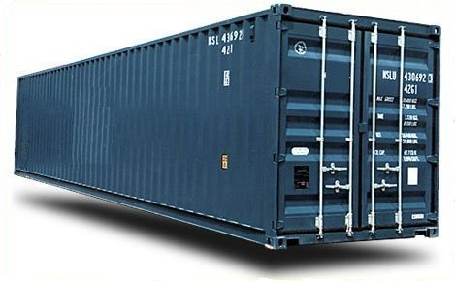
{{ Module }}
Modules are container for:
Controllers
Factories/Services
Directives
Filters
Routes

Slide 21
{{ What are Factories/Services ? }}
Used to me RESTful calls
Used to share data between controllers
Used to handle custom logic
Are Singleton

Slide 22
{{ What is Controllers? }}
Controllers act as the brain for a view:
Retrieve data from factories/services
Handle events use/triggered by the view
Rely on the $scope object to interact with the view

Slide 23
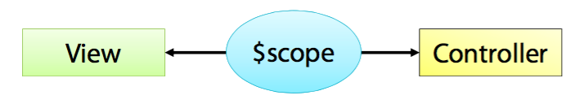
{{ What is Scope? }}
$scope is the "glue" (ViewModel) between a controller and a view

Slide 24
{{ What are Views? }}
Views render user interface:
Contain HTML and CSS
Bind to data provided by a controller via the $scope object or (this.[object]
Use directives to enhance HTML and render data

Slide 25
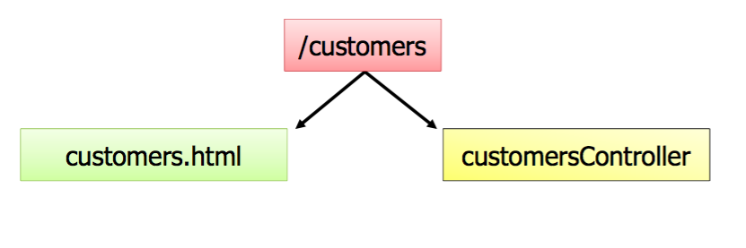
{{ What are Routes? }}
Reference to controller and view
Can include route parameters:
/customers/:id

Slide 26


Slide 27
{{ Q&A }}
What are the key’s to learn Angular?
Understand the available parts
Understand how the parts fits together
Understand how to organize parts
How does angular key components fits together? (Summary)

Slide 28
{{ Summary }}
AngularJS is a full-featured SPA framework
Applications are organized into one or more containers (modules)

Slide 29

{{ Deep Dive }}

Slide 30
{{ View, Directives and Filters }}
Data Binding
Directive Expression
Iteration
Sorting and Formating

Slide 31
{{ Big Picture }}

Slide 32
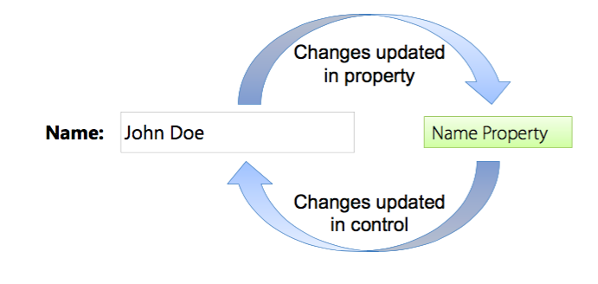
Data Binding
Javascript doesn’t provide native support for data binding
Two-way data binding can lead significant reductions code.

Slide 33
{{ Demo }}

Slide 34
{{ Directives and Expression }}

Slide 35

{{ What is Directives? }}
Directives teach HTML new tricks.

Slide 36
{{ What can Directives do? }}
DOM Manipulation
Data Binding
Controllers
View Loading
Events

Slide 37
{{ AngularJS Directives }}
DOM Manipulation
ng-hide
ng-repeat
ng-show
ng-view
Controllers/Modules
ng-app
ng-controller
ng-show
and many more…

Slide 38
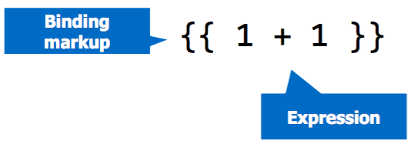
{{ Angular Expression }}
Expression are code snippets place in binding markup:

Slide 39
Iteration with Data

Slide 40
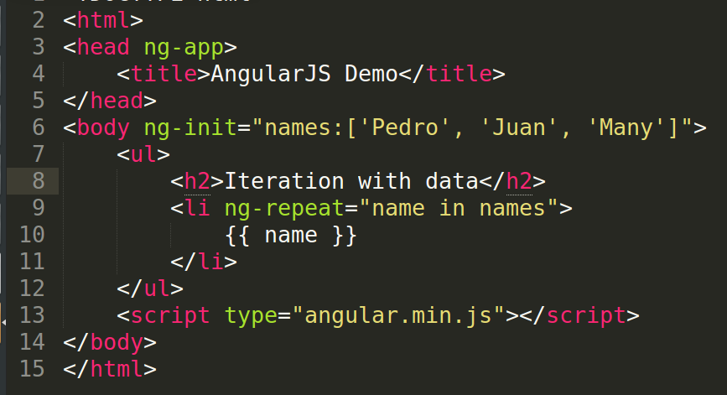
Iteration with ng-repeat Directive

Slide 41

Sorting and Formating Data

Slide 42
Filters and Pipe
AngularJS can pipe data through filtering, formating and sorting function.
Use the “|” character

Slide 43
Angular Filters
currency
date
filter
json
limitTo
orderBy
and many more….

Slide 44
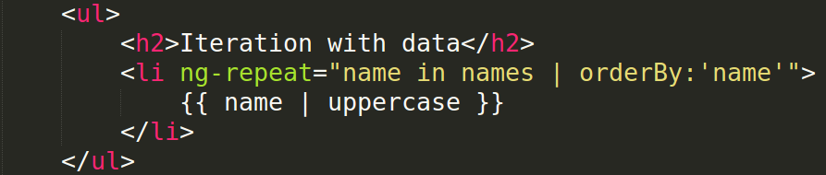
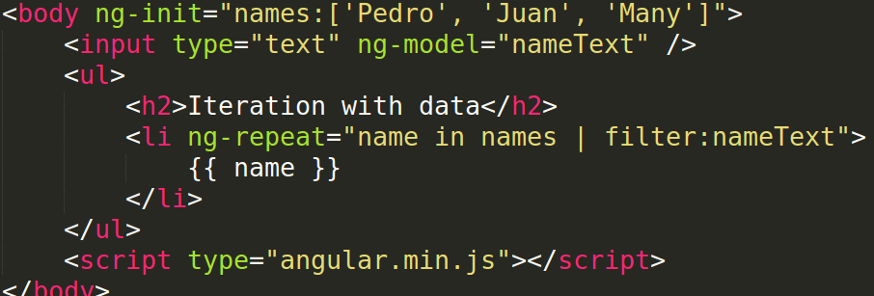
Example:

Slide 45
Demo

Slide 46
Q&A
Games Q&A
[Insert Questions here to answer by audience]

Slide 47
Exercise
List array of names using ng-repeat, initialize it in the body using ng-init.
Sort the list by name asc order
Add input text tag to filter list of names.

Slide 48
Summary
Views handle UI functionality
Filters are used to format, sort and filter data
Directives enhance HTML
Manipulate DOM
Used to reference model properties
And Many More…

Slide 49
Modules, Controllers and Scope

Slide 50
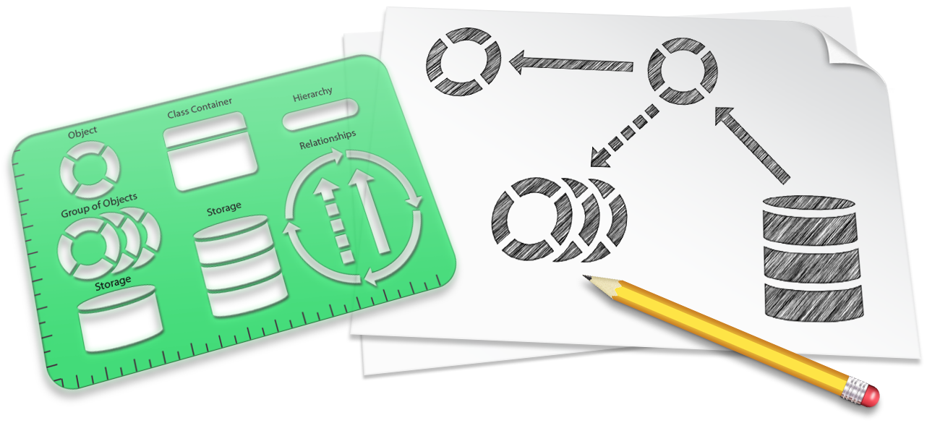
AngularJS Architecture Patterns
AngularJS relies on two key architecture patterns
Model-View-Controllter (MVC)
Mode-View-ViewModel (MVVM)
Patterns provide perspective guidance that can be used to build applications.

Slide 51
The Roles of Controllers
AngularJS act as the brain for the view:
Defines properties and methods
Handles showing/hiding controls and data in a view
Handles events triggered by a view
Knows how to retrieve data
Interacts with the view using the $scope object

Slide 52
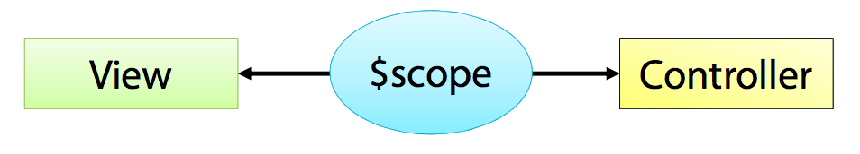
The role of $scope
$scope is injected to the controller
Act as the viewModel
Views bind to scope properties and functions

Slide 53
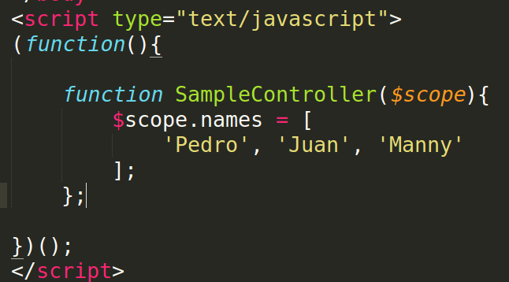
Creating a Controller

Slide 54
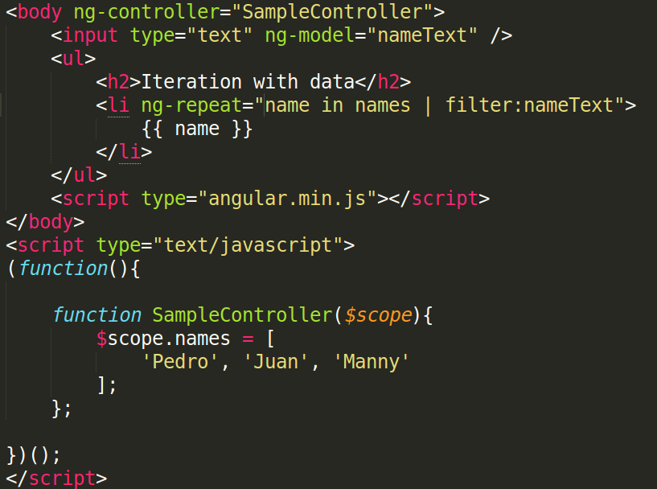
Using ng-controller directive

Slide 55
Exercise
List array of names using ng-repeat, use ng-controller to get the list of names
Sort the list by name asc order
Add input text tag to filter list of names.

Slide 56
The Role of Modules

Slide 57
What is Module?
Modules are container for:
Controllers
Factories/Services
Directives
Filters
Routes

Slide 58
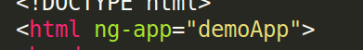
Defining a Module
Create a module using angular.module()

Slide 59
Injecting Dependencies in Module
Modules may rely on functionallity from other modules.
Helper modules can be injected into a module.

Slide 60
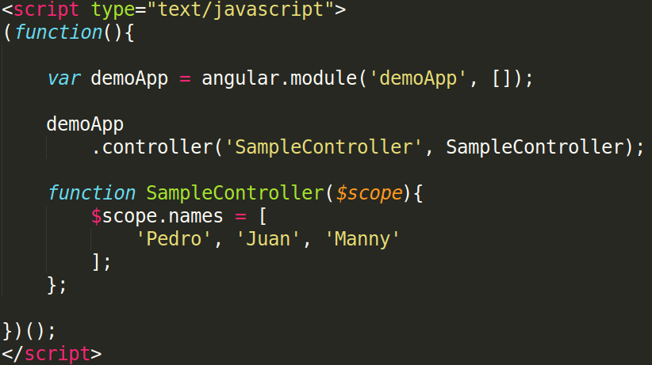
Adding Controller to a Module

Slide 61
Exercise
Create a module bootstrap, using ng-app in html tag.
Create a controller, contains list of names.
Add controller to module
List array of names using ng-repeat, use ng-controller to get the list of names
Sort the list by name asc order
Add input text tag to filter list of names.

Slide 62
Summary
AngularJS relies on the MVC and MVVM architectural pattern.
Controllers act as a brain for the view:
Know how to retrieve and store data
Interact views using $scope.
Module act as a containers for AngularJS app.

Slide 63
Routing

Slide 64
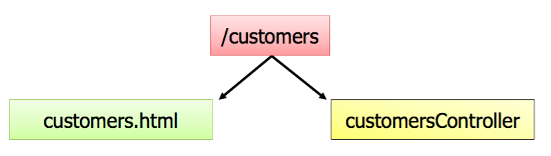
Routing Overview
AngularJS routes associate a view with a controller.
Relies on ngRoute module.
Routes configure using $routeProvider.

Slide 65
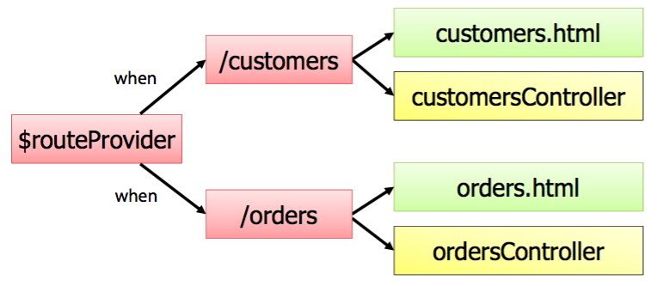
Routing and Modules
Routes configured by calling angular.module.config()
$routeProvider injected dynamically.

Slide 66
ngRoute Module
AngularJS routing functionality is located in the ngRoute module.
Reference ngRoute in your module.

Slide 67
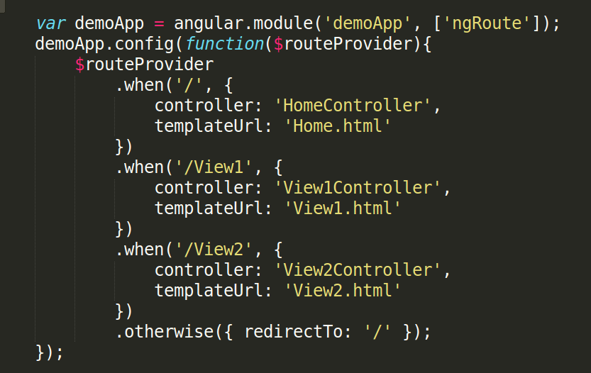
Configuring Routes

Slide 68
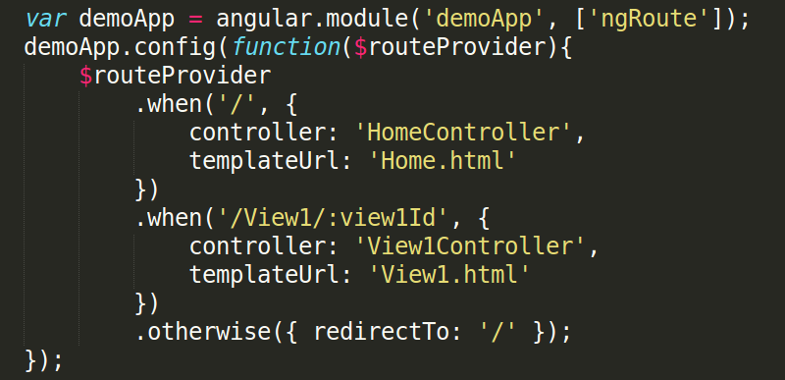
Configuring Routes
Route Parameters
Example Route: /View1/2345

Slide 69
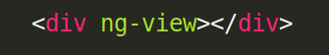
Using ng-view Directive as shell
Dynamically loaded views are injected into the shell page as a module loads:

Slide 70
Exercise

Slide 71
Summary
AngularJS provides built-in support for routing and history management
Routes associate a view with a controller
Reference the ngRoute module

Slide 72
Factories and Services

Slide 73
Factories and Services Overview
AngularJS support the concept of factories and services.
Includes several built-in factories and services
Singletons that perform re-usable tasks.
Ajax calls
Business rules
Calculations
Shared data between controllers

Slide 74
Built-in AngularJS Services
AngularJS provides many built-in services
$http
$location
$timeout
$q

Slide 75
Creating Factory and Service

Slide 76

What is factory?
Create custom factory when you need it.
Define re-usable tasks
Share code or state between controllers
Factories
Create and return a custom object
Can be inject into other components
Can have dependencies

Slide 77
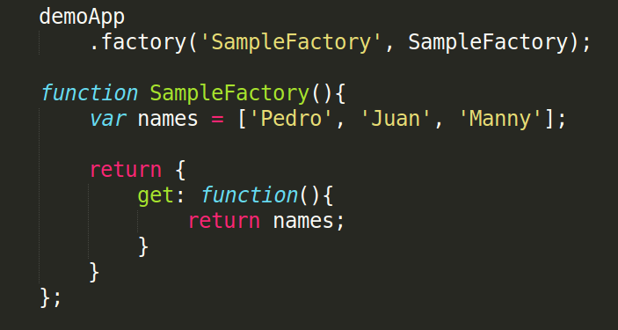
Creating Factory

Slide 78

What is a Service?
Semilar to a factory as far as functionality.
Services:
Service function represents the returned object as opposed to a custom object like in a factory
Can be injected into other components
Can have dependencies

Slide 79
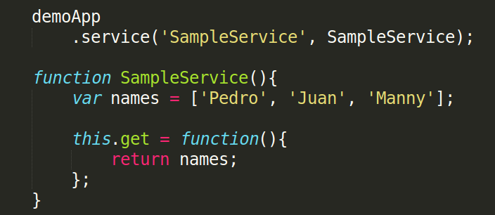
Creating a Service

Slide 80
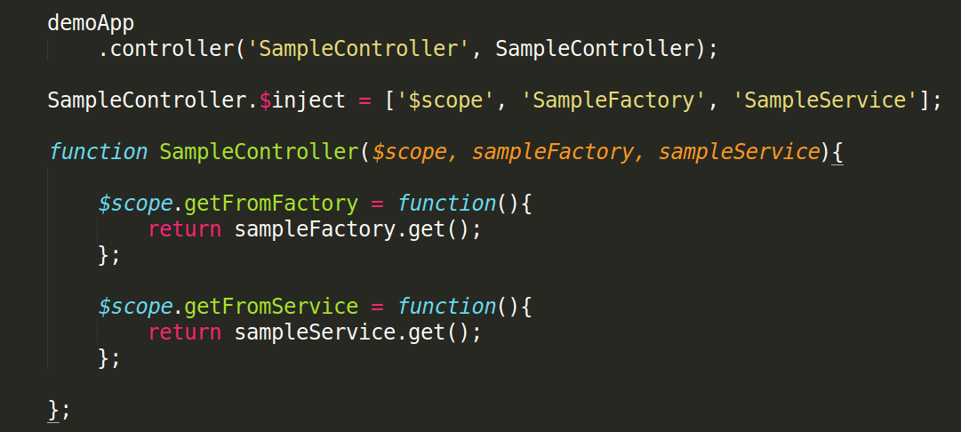
Injecting a Factory and Service

Slide 81
Exercise
Move the list of names in Service/Factory
Inject the Service/Factory to Controller

Slide 82

Making Ajax Calls from a Factory/Service

Slide 83
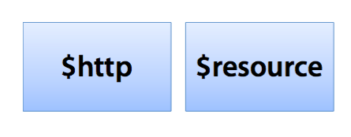
AngularJS and Ajax
AngularJS services can used to make Ajax calls.

Slide 84
The $http Service
The $http services provides Ajax functionality
Uses the browser's XmlHttpRequest object
Makes asynchronous requests
Supports multiple HTTP verbs:
$http.get
$http.post
$http.put
$http.delete

Slide 85
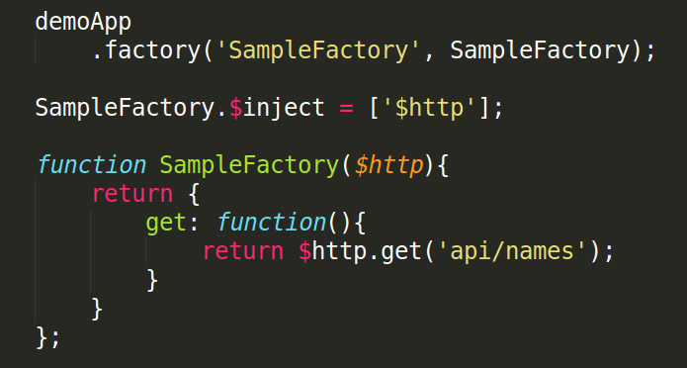
Using $http service

Slide 86
Exercise
Create a json file i.e names.json to fake the service call.
Update the SampleFactory to call to api using $http.get()

Slide 87
Summary
Factories and Services are singleton
Provide a place to store re-useable tasks:
Ajax calls
Business rules
More…
Access by injecting the factory/service

Slide 88
Mini Project

